Slide 1

Cross-platform mobile application with Xamarin.Forms and Integration with Azure DevOps

Slide 2

_Codrina_
codrinamerigo
Codrina Merigo
codrinamerigo

Slide 3
What is Xamarin?

Slide 4
An open source app platform from Microsoft for building modern & performant iOS, Android, macOS,
watchOS, & tvOS apps with .NET.

Slide 5
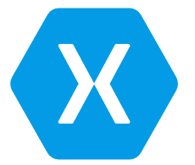


Xamarin is for devs with the following goals:
Share code, test and business logic across platforms
Write cross-platform applications in C# with Visual Studio
.NET
C#
C#
C#
Shared C#
Business Logic • Platform APIs • User Interface
Notes:
No matter the underlying technology, the importance is on code sharing

Slide 6
What is Xamarin.Forms?

Slide 7
An open source mobile UI framework
from Microsoft for building
iOS, Android, & Windows apps with .NET
from a single shared codebase.

Slide 8

Xamarin.Forms is for devs with the following goals:
Share UI layout and design across platforms.
.NET
C#
C#
C#
Xamarin.Forms - UI
Shared C#
Business Logic
Notes:
Xamarin.Forms is a feature of Xamarin, the popular mobile development framework that extends the .NET developer platform with tools and libraries for building mobile apps.
Xamarin.Forms is an open source cross-platform framework from Microsoft for building iOS, Android, & Windows apps with .NET from a single shared codebase.
Use Xamarin.Forms built in pages, layouts, and controls to build and design mobile apps from a single API that is highly extensible. Subclass any control to customize their behavior or define your own controls, layouts, pages, and cells to make your app pixel perfect.
Apps built using Xamarin have access to the full spectrum of functionality exposed by the underlying platform and device, including platform-specific capabilities like ARKit, CoreML, Fingerprint, Bluetooth, NFC, and more!
Xamarin also integrates with thousands of third-party libraries including Google Play services, Facebook, Google APIs for iOS. You can even bring your favorite native iOS and Android libraries to Xamarin applications with "Binding" projects.
Apps built using Xamarin leverage platform-specific hardware acceleration, and are compiled for native performance.
Perform a full ahead-of-time (AOT) compilation on apps to reduce startup time, increase memory sharing, and improve performance.

Slide 9

Xamarin
Xamarin extends .NET
Xamarin extends the .NET platform with tools and libraries specifically for building apps on iOS, Android, macOS, and more
Xamarin.Forms is a feature of Xamarin and is more than just a cross-platform UI library, it is a full application framework that includes everything you need to build mobile apps.
Notes:
Xamarin.Forms is a feature of Xamarin, the popular mobile development framework that extends the .NET developer platform with tools and libraries for building mobile apps.
Xamarin.Forms is an open source cross-platform framework from Microsoft for building iOS, Android, & Windows apps with .NET from a single shared codebase.
Use Xamarin.Forms built in pages, layouts, and controls to build and design mobile apps from a single API that is highly extensible. Subclass any control to customize their behavior or define your own controls, layouts, pages, and cells to make your app pixel perfect.

Slide 10

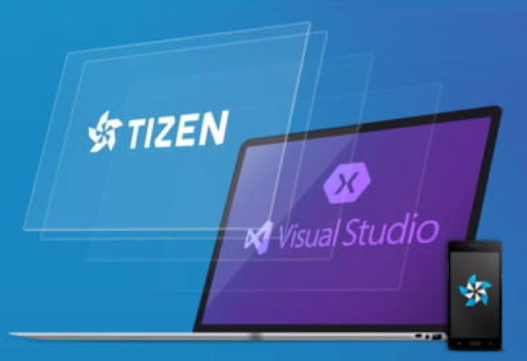
Not only iOS and Android Apps
iOS 9 or higher.
Android 4.4 (API 19) or higher
Android 5.0 (API 21) is recommended as the minimum API.
Windows 10 Universal Windows Platform.
Samsung Tizen
macOS 10.13 or higher
GTK#
WPF
Notes:
Xamarin.Forms Today - version

Slide 11
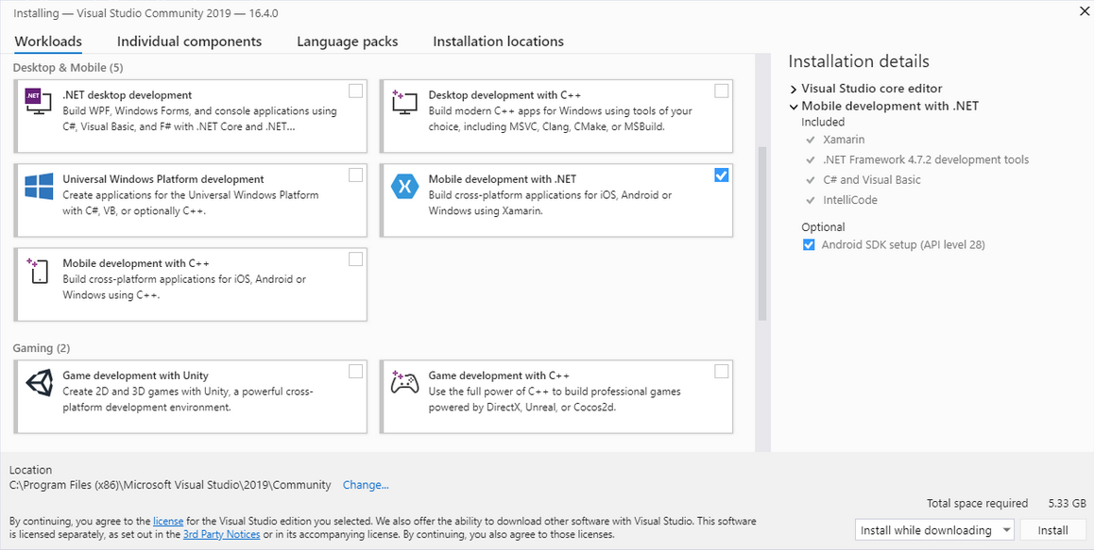
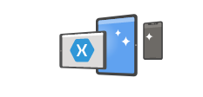
Visual Studio 2019 setup
Notes:
Xamarin.Forms Today - version

Slide 12
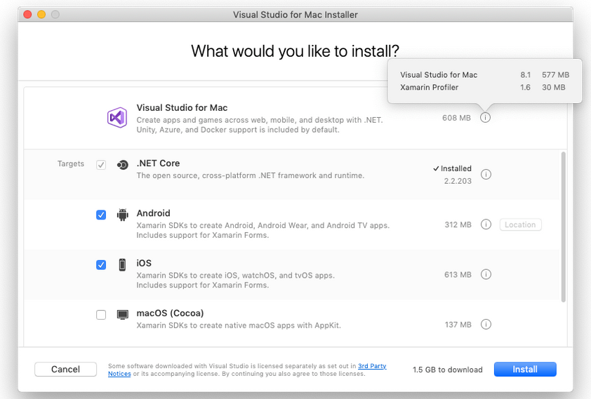
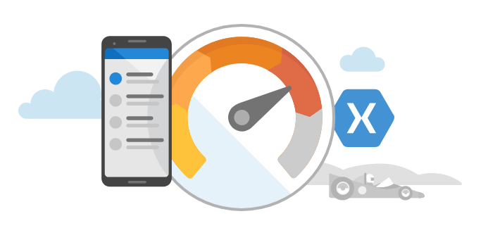
Visual Studio for Mac
Notes:
Xamarin.Forms Today - version

Slide 13


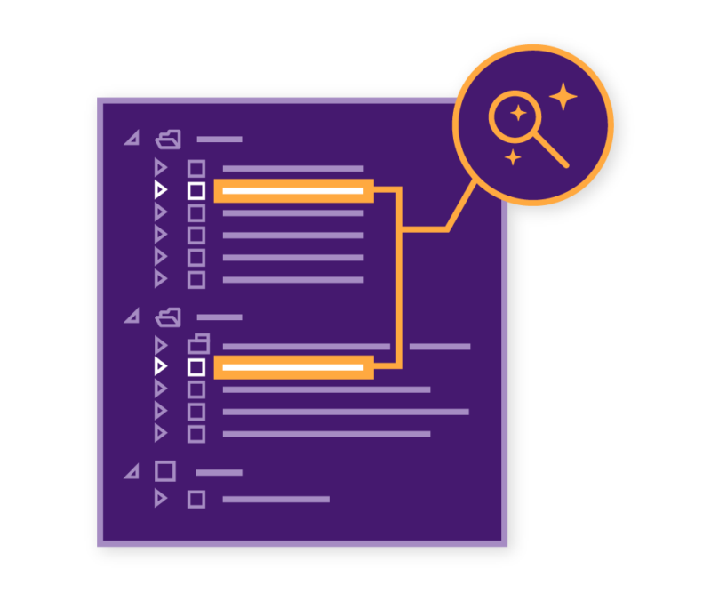
Visual Studio 2019 IntelliCode
Code with confidence
Find issues Faster
Focused code reviews
Notes:
There is a lot more that Visual Studio offers such as intellicode which helps you write code faster with AI assisted Intellisense.

Slide 14
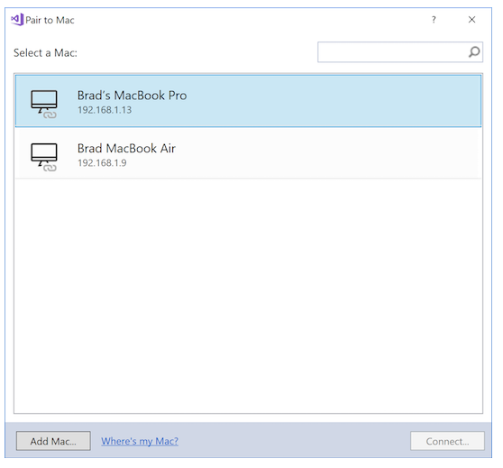
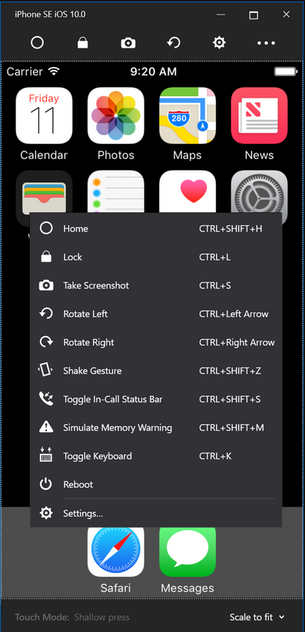
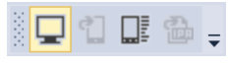
Connect to Mac
The Remoted iOS Simulator for Windows allows you to test your apps on an iOS simulator displayed in Windows alongside Visual Studio 2019
Notes:
Xamarin.Forms Today - version

Slide 15
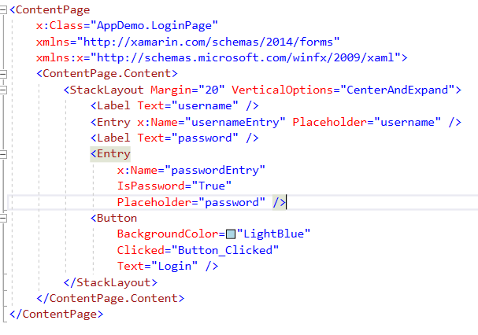
Declarative User Interface or not
Build user interfaces declaratively with XAML and share them across mobile and desktop platforms. However, if XAML is not your cup of tea, you can create equally powerful and performant UIs using C# instead.
Notes:
Views are user-interface objects such as labels, buttons, and sliders that are commonly known as controls or widgets in other graphical programming environments. The views supported by Xamarin.Forms all derive from the View class. T

Slide 16

Model-View-ViewModel (MVVM)
MVVM is a design pattern used to decouple user-interface (view), data (model), and application logic (view model). Xamarin has built-in support for the MVVM pattern including data binding, making it easy to follow this design pattern so that you can create application code that's better tested and easier to extend without requiring radical changes.

Slide 17
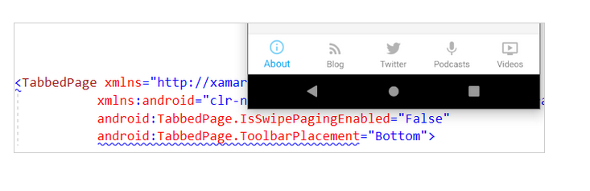
Access native platform features
Easily integrate native user interface features with platform specifics such as iOS Safe Area, Android elevation, and Windows ListView selection mode both from C# and XAML.

Slide 18
Native performance
ARM BINARY
IL + JIT
.NET
.NET
.NET
AOT
.APP
Compile and Link
.APK
C#
C#
C#
Runs natively
Runs natively
Bindings
Bindings
Bindings
Xamarin.iOS does full Ahead Of Time (AOT) compilation to produce an ARM binary for Apple’s App Store.
Xamarin.Android takes advantage of Just In Time (JIT) compilation on the Android device.

Slide 19
DEMO

Slide 20

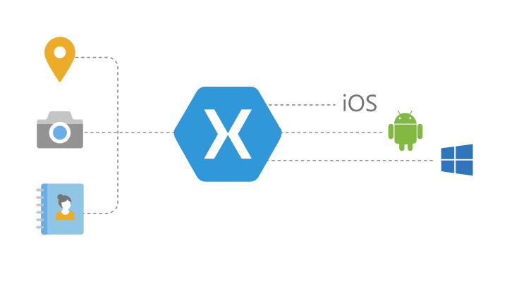



Xamarin.Forms additional resources
Xamarin.Essentials
Shell
Platform-specifics
Material Visual
Notes:
Xamarin.Forms Today - version

Slide 21
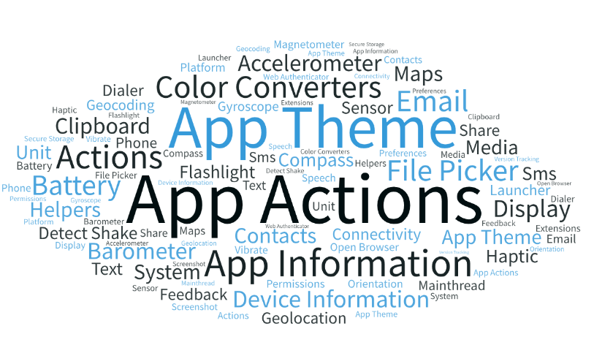
Xamarin.Forms additional resources
Xamarin.Essentials - simplified access to native utilities
Android, iOS, and UWP offer unique operating system and platform APIs that developers have access to all in C# leveraging Xamarin. Xamarin.Essentials provides a single cross-platform API that works with any Xamarin.Forms, Android, iOS, or UWP application that can be accessed from shared code no matter how the user interface is created.
Notes:
Xamarin.Forms

Slide 22
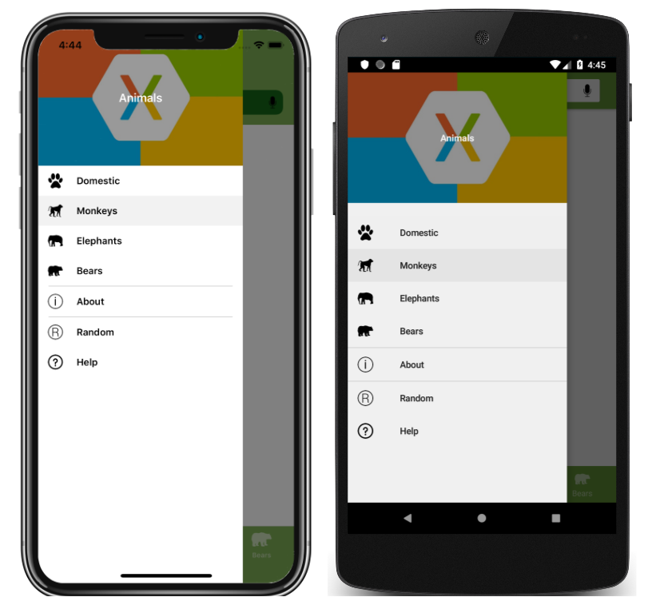
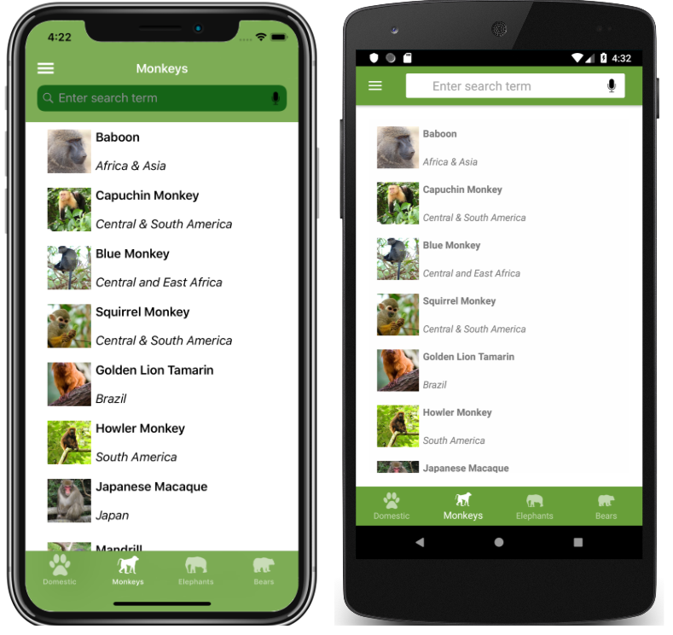
Xamarin.Forms additional resources
Shell - fundamental features: Common navigation experience, URI-based navigation
scheme,Integrated search handler
Shell provides an opinionated navigation experience, based on flyouts and tabs. The top level of navigation in a Shell application is either a flyout or a bottom tab bar, depending on the navigation requirements of the application.
Selecting a flyout item results in the bottom tab that represents the item being selected and displayed
Notes:
A single place to describe the visual hierarchy of an application.
A common navigation user experience.
A URI-based navigation scheme that permits navigation to any page in the application.
An integrated search handler.
In addition, Shell applications benefit from an increased rendering speed, and reduced memory consumption.

Slide 23
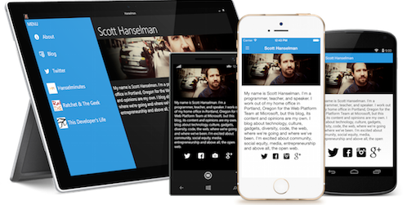
Xamarin.Forms additional resources
Platform-specifics - utilize functionality that is only available on a specific platform without creating custom renderers or effects.
Platform specifics allow you to enhance a control in Xamarin Forms on a particular platform.
Different Platform specifics are available for both Android and iOS that can vary from Visual elements, to specified keyboard or custom navigation modes.
Usually used for fine-tuning the User Interface.
Notes:
Xamarin.Forms Today - version

Slide 24

Xamarin.Forms additional resources
Material Visual - apply Material Design(opinionated design system created by Google) rules easily in order to have a consistent look and feel across iOS and Android.
When Material Visual is enabled, supported views adopt the same design cross-platform, creating a unified look and feel.
Also re-usable UI components from top component vendors like Syncfusion, DevExpress, UX Divers, GrapeCity, Telerik, and others.
Notes:
Members of the community are rebooting this library under the guidance of the Xamarin team. The Xamarin Community Toolkit is a collection of common elements for mobile development with Xamarin.Forms that people tend to replicate across multiple apps. It simplifies and demonstrates common developer tasks when building apps with Xamarin.Forms. If you're looking for the historical code to reference, please check the legacy branch.

Slide 25



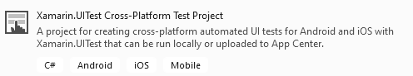
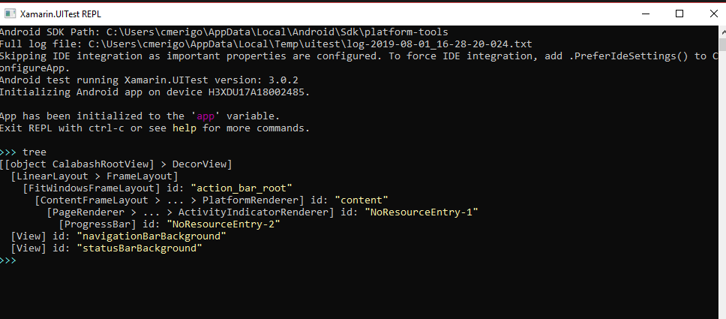

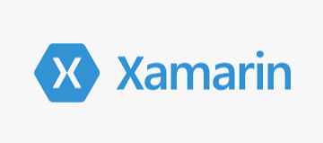
Testing
nUnit
xUnit.net
VSTest

Slide 26


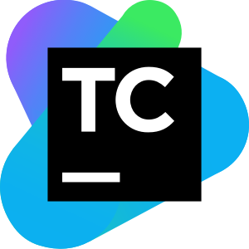


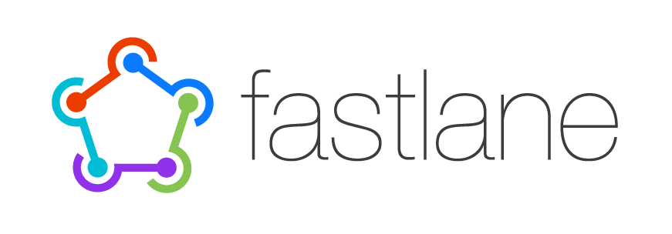
Continuous Integration & Delivery
Azure
Devops
Team
City
App
Center
Jenkins

Slide 27

Integration with Azure DevOps
Prerequisites:
An Azure account with an active subscription.
An active Azure DevOps organization.
Trigger (as the name suggests) works on a push to specific branches.
e.g. the build will start only when we push something to the master branch.
Pool is an agent pool on which build will run; by default, it uses Azure Agents Pool.
Custom variables $(variable)
Optional:
yaml knowledge https://aka.ms/yaml

Slide 28
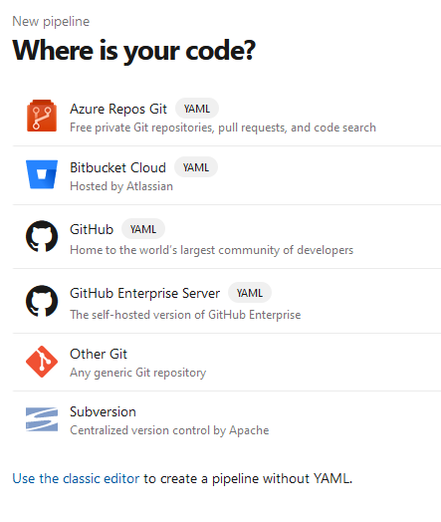

Connect your app

Slide 29
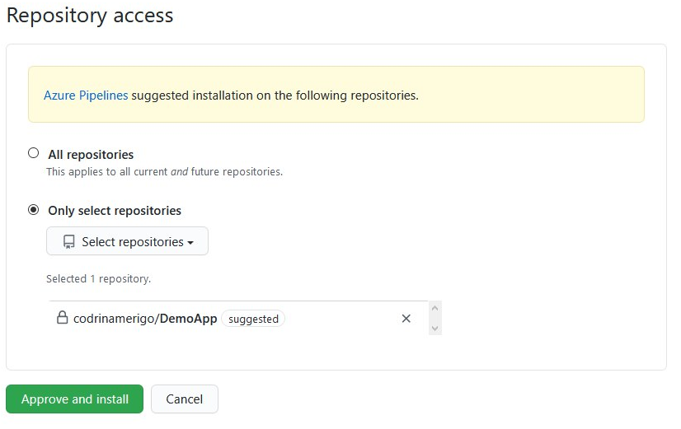
Connect your app - GitHub

Slide 30
DEMO

Slide 31
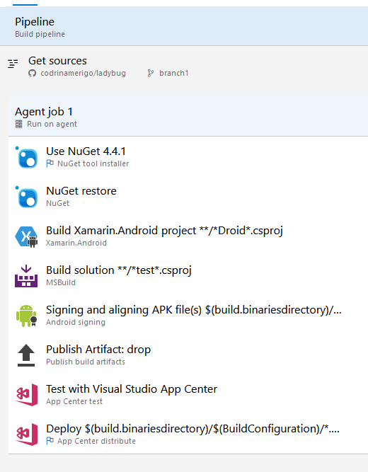
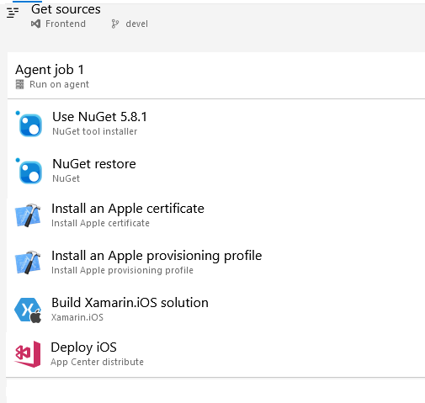
Basic android and iOS pipelines

Slide 32

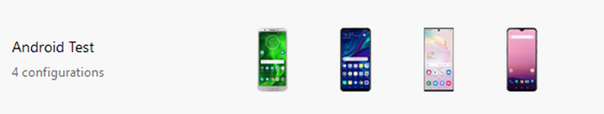
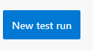


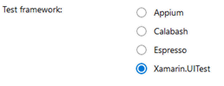




Run UI Tests on Appcenter Test Cloud
Run on first device when ready
Configure your run by selecting
Upload package and UI Test
using nodeJs and following
app center instruction
appCenter
Validation
Wait for
devices
Run on second device when ready
Generate report for results
Run on third device when ready
Run on nth device when ready

Slide 33
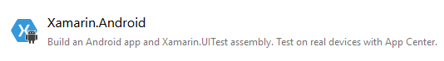
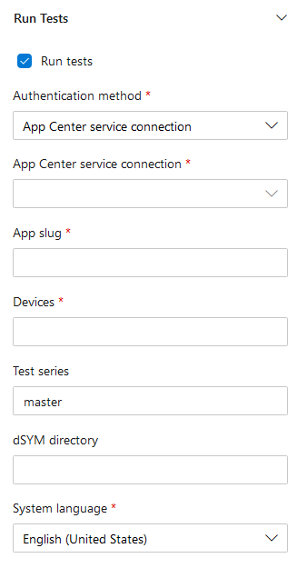

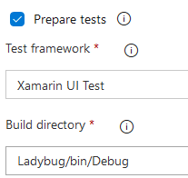
Add UI Tests to DevOps using AppCenter
Enable task
From app center you get:
appcenter test run uitest
--app "codrinamerigo/LadyBug"
--devices "codrinamerigo/android-test"
--app-path pathToFile.apk
--test-series "master"
--locale "en_US"
--build-dir pathToUITestBuildDir

Slide 34
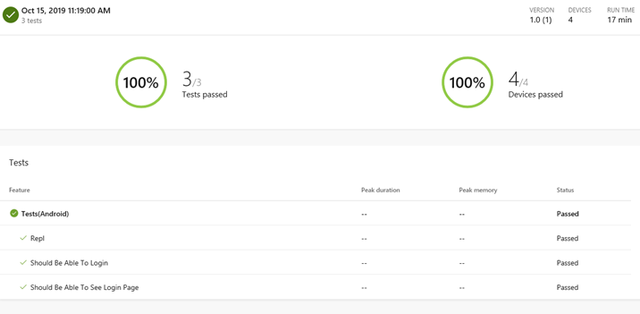
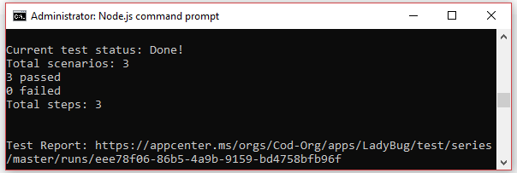
App Center Test Cloud Reports

Slide 35
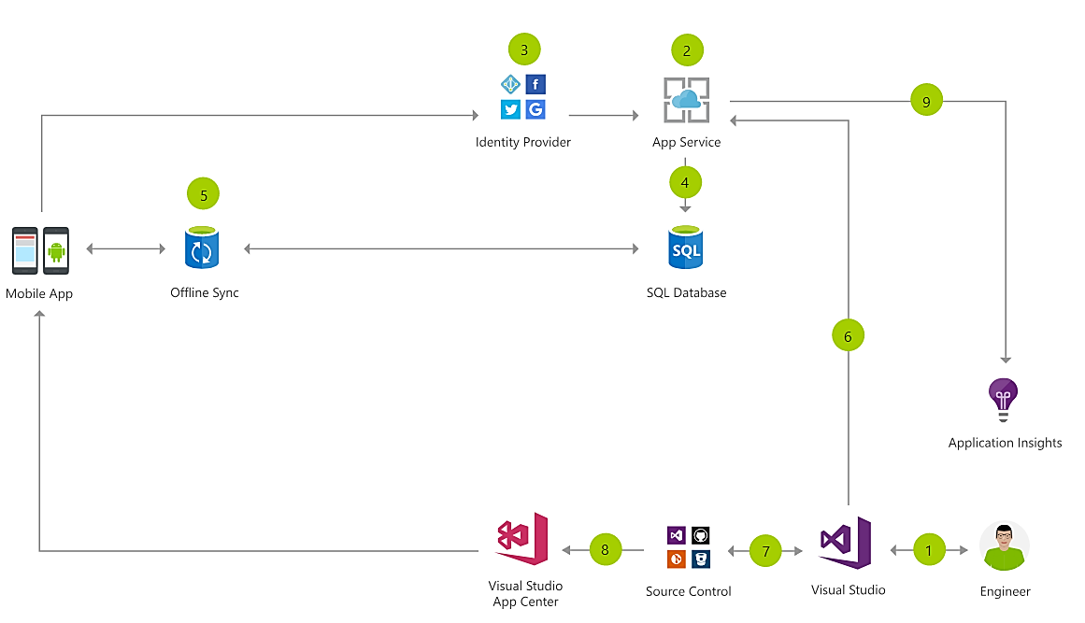
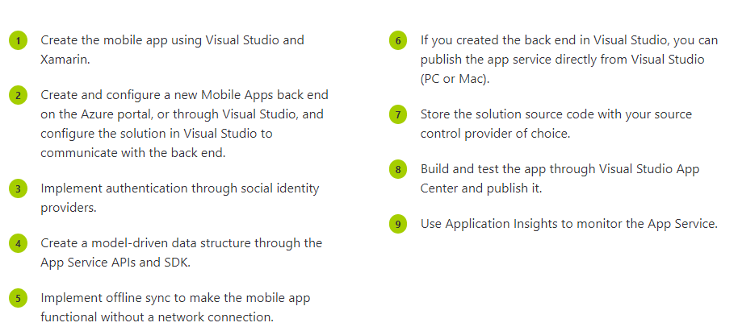
Cloud Mobile App Architecture
Notes:
Here is an example of what a cloud mobile app may look like.
You have your app, with identity providers with Azure AD B2C, and app service talking to SQLite and a sync later using App Service. You can export all of your data into App Insights and continuously monitor and ship with Azure DevOps and App Center.

Slide 36





























Xamarin
Loved by developers, trusted by enterprise
Notes:
In fact there are tons of companies that entrust Xamarin and .NET today.
These companies leverage Xamarin and .NET across all verticals and all different types of platforms.

Slide 37
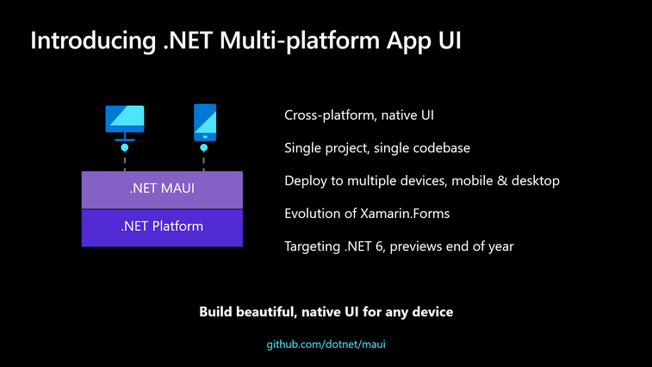
Notes:
.NET MAUI is an evolution of the increasingly popular Xamarin.Forms toolkit that turns 6 years old this month. For years companies such as UPS, Ernst & Young, and Delta have been leveraging the mobile expertise of Xamarin atop .NET to power their businesses; some since the very beginning. It has also been very successful in helping small businesses maximize their development investment sharing upwards of 95% of their code, and beating their competitors to market. .NET MAUI extends this success on mobile to embrace the desktop making it the best way to build multi-platform applications across both, especially our new devices such as the new Surface Duo.
.NET MAUI simplifies the choices for .NET developers, providing a single stack that supports all modern workloads: Android, iOS, macOS, and Windows. The native features of each platform and UI control are within reach in a simple, cross-platform API for you to deliver no-compromise user experiences while sharing even more code than before.
Single Project Developer Experience
.NET MAUI is built with developer productivity in mind, including the project system and cross-platform tooling that developers need. .NET MAUI simplifies the project structure into a single project to target multiple platforms. This means you can easily deploy to any target that you wish including your desktop, emulators, simulators, or physical devices with a single click. With built-in cross-platform resources you will be able to add any images, fonts, or translation files into the single project, and .NET MAUI will automatically setup native hooks so you can just code. Finally, you will always have access the native underlying operating system APIs and it will be easier than ever with new platform specific integrations. Under platforms you can add source code files for a specific operating system and access the native APIs. With .NET MAUI everything is in one place where you need it to keep you productive.

Slide 38
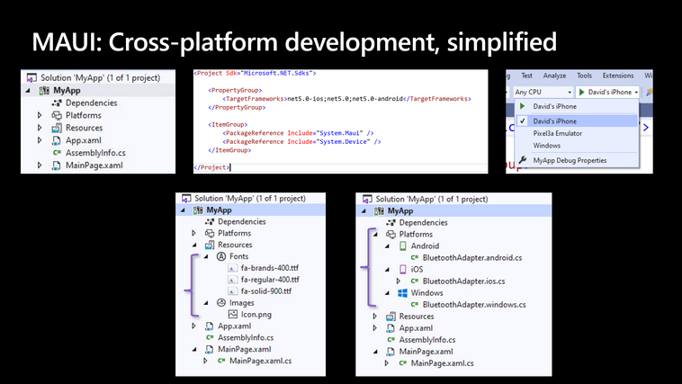
.NET MAUI
Notes:
.NET MAUI is built with developer productivity in mind, including the project system and cross-platform tooling that developers need. .NET MAUI simplifies the project structure into a single project to target multiple platforms. This means you can easily deploy to any target that you wish including your desktop, emulators, simulators, or physical devices with a single click. With built-in cross-platform resources you will be able to add any images, fonts, or translation files into the single project, and .NET MAUI will automatically setup native hooks so you can just code. Finally, you will always have access the native underlying operating system APIs and it will be easier than ever with new platform specific integrations. Under platforms you can add source code files for a specific operating system and access the native APIs. With .NET MAUI everything is in one place where you need it to keep you productive.
One project targeting multiple platforms and devices
One location to manage resources such as fonts and images
Multi-targeting to organize your platform-specific code
Part of the vision for one .NET is providing developer choice in the areas of personal preferences so you can be most productive using .NET. This manifests in which IDE you use whether Visual Studio 2019, Visual Studio for Mac, or even Visual Studio Code. .NET MAUI will be available in all of those, and support both the existing MVVM and XAML patterns as well as future capabilities like Model-View-Update (MVU) with C#, or even Blazor.
Model-View-ViewModel (MVVM) and XAML, the predominant pattern and practice among .NET developers for decades now, are first-class features in .NET MAUI. This will continue to grow and evolve to help make you productive building and maintaining production apps. In addition, we are enabling developers to write fluent C# UI and implement the increasingly popular Model-View-Update (MVU) pattern. MVU promotes a one-way flow of data and state management, as well as a code-first development experience that rapidly updates the UI by applying only the changes necessary.

Slide 39

.NET MAUI
Transitioning from Xamarin.Forms to .NET MAUI
Xamarin.Forms developers will hit the ground running with new projects in .NET MAUI, using all the same controls and APIs they have grown to know and love. As we get closer to the .NET MAUI launch, In order to help developers make a smooth transition of existing apps to .NET MAUI we intend to provide try-convert support and migration guides similar to what we have today for migrating to .NET Core.
.NET MAUI General Availability (November 2021)
Notes:
github

Slide 40
codrinamerigo
_Codrina_
codrinamerigo

